Slide 1

Class Presentation Chapter 6: Emotional Interaction
AUBURN UNIVERSITY
User Interface Design and Evaluation
Professor: Dr. Seals
Presentation By: Sidharth Suresh Gautam ,Daniel Benjamin, Maryam Bigonah, Nikshep Bikkumalla, Jacob Blair

Slide 2
Topic
Jacob - Topic : 6.1: Introduction & 6.2: Emotions and the User Experience
Effect of technology on emotion Examples of emotionally designed products Happyornot terminals (Activity) How do emotions affect behavior? The levels of the brain
Sidharth Topic: 6.3: Expressive Interfaces and Emotional Design
What is Expressive Interfaces?
What is Emotional Design?
History of Expressive Interfaces and Emotional Design
Techniques of Expressive Interfaces and Emotional Design
Ways of Expressive Interface?
Aesthetically Interfaces
The Design of the Nest Thermostat Interface?
Maryam Topic: 6.4 Annoying Interface
When is the annoying interface? What are the samples of annoying interfaces? How a template can distract, intrusive users? What are the effects of bad designs? What are the situations that cause negative emotional responses?
Nikshep Topic: 6.5 Affective computing and emotional AI
What is Affective computing? Techniques and Technologies of AI Applications of Emotional AI Is It OK for Technology to Work Out How You Are Feeling?
Daniel Topic: 6.6 Persuasive Technologies and Behavioral Change & 6.7 Anthropomorphism
How emotional technologies can be designed to persuade people to change their behaviors or attitudes?
What is Persuasive Design?
- Examples of Persuasive Design
Overview of Technology interventions
- Premise of Technology Inteventions
- Examples of Technology Interventions
How social norms influence user behavior?
- Definition of Antropomorphism
- How Antropomorphism is used to elicit positive emotional responses to users and ways of avoiding negative ones
- Examples of Anthropomorphism
*Activity : A YouTube video

Slide 3
Jacob - Topic : 6.1: Introduction & 6.2: Emotions and the User Experience

Slide 4
Effect of Technology on Emotion
Imagine
You’re having a terrible day/week/month/etc
A wearable technology device could sense this and try to help
How would this device make you feel?
Affective AI - Designing technology to detect and alter emotions
Emotional Design - Cause desired emotional states

Slide 5
Effect of Technology on Emotion
Affective AI + Emotional Design
Emotional Interaction

Slide 6
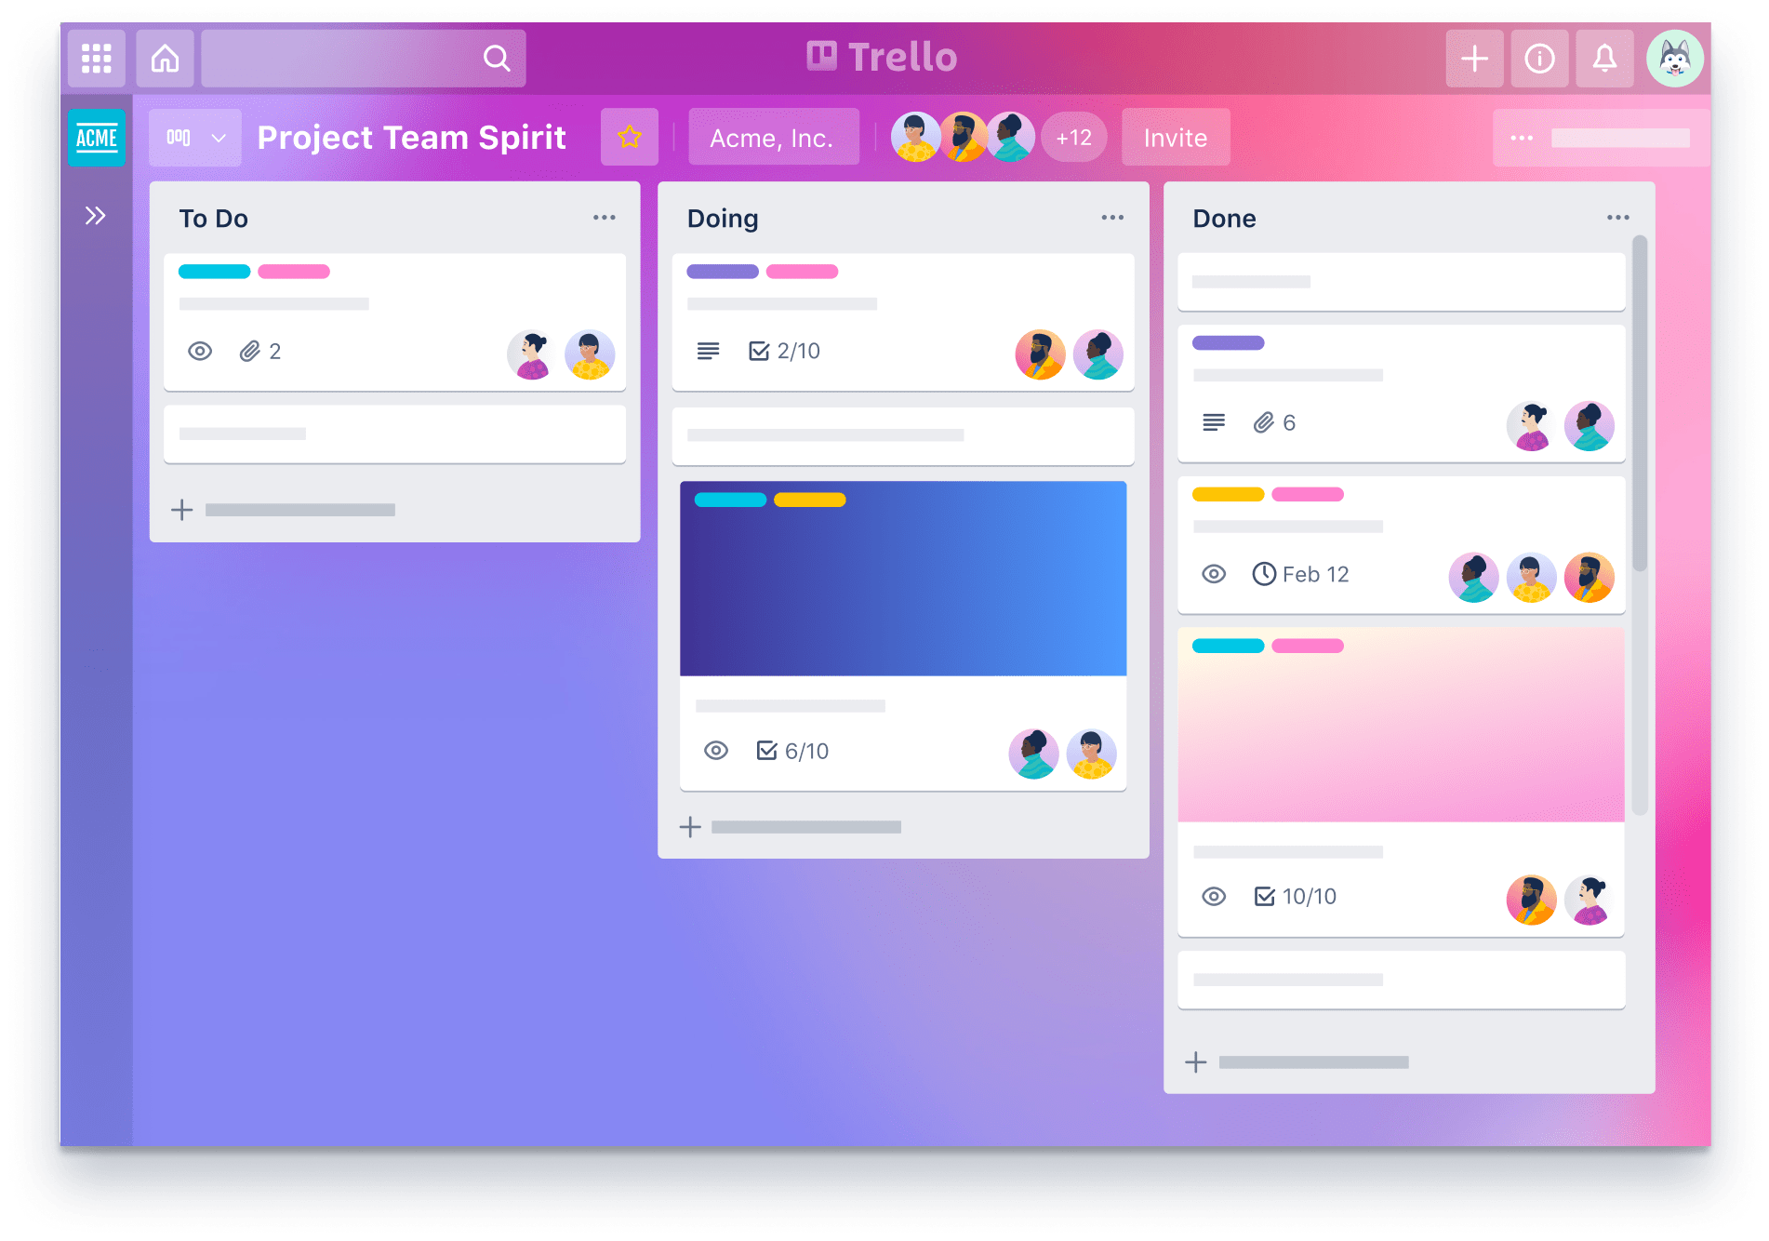
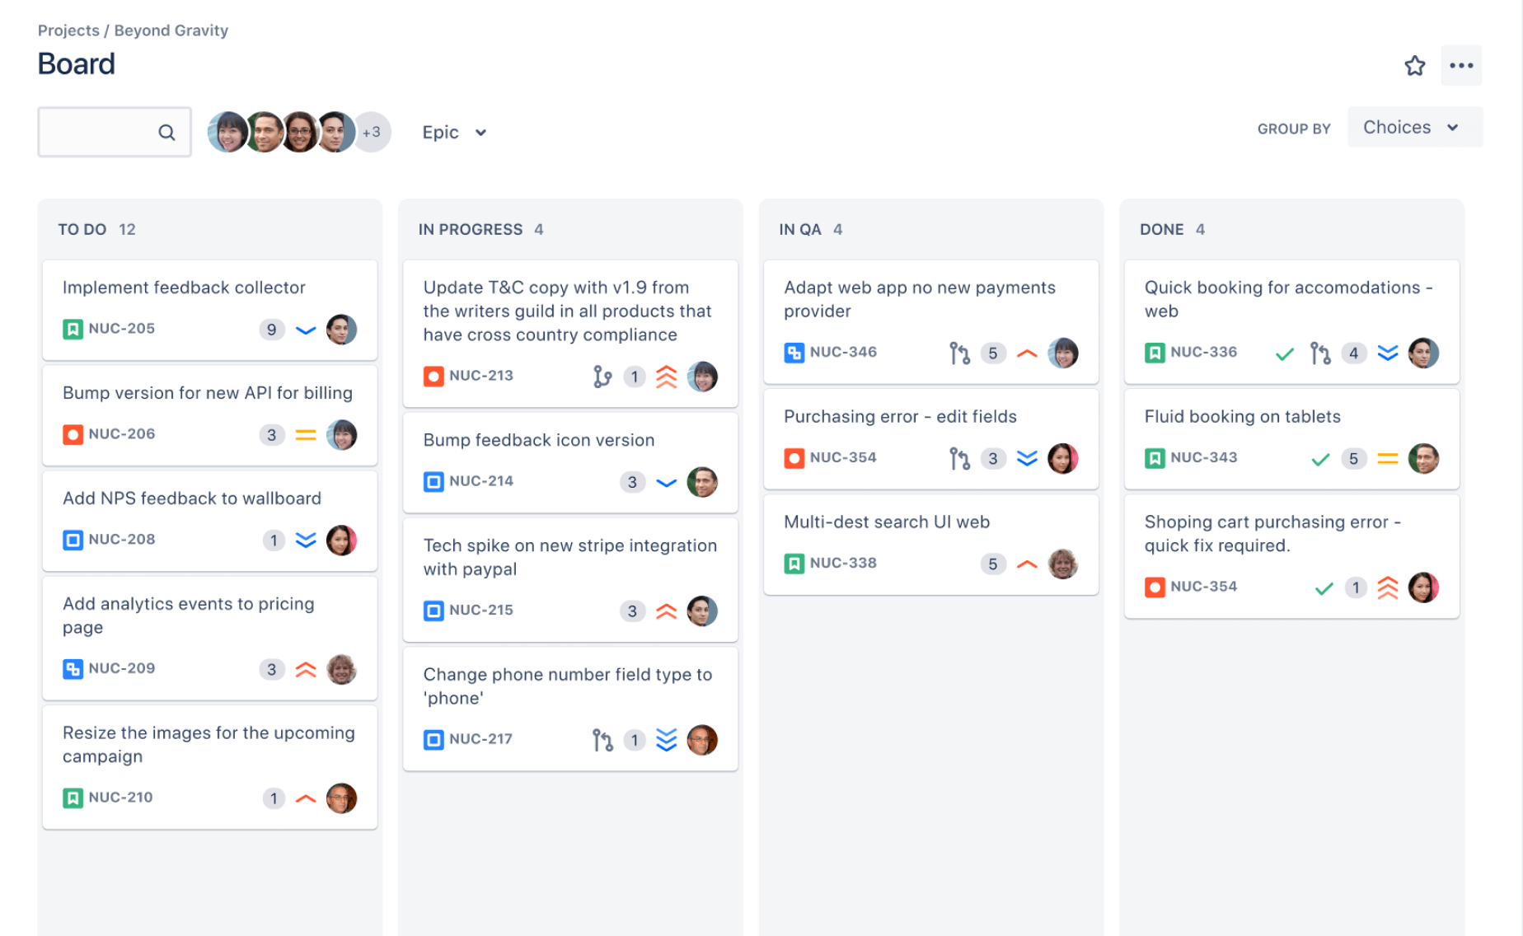
Examples of Emotional Interaction in Products

Slide 7

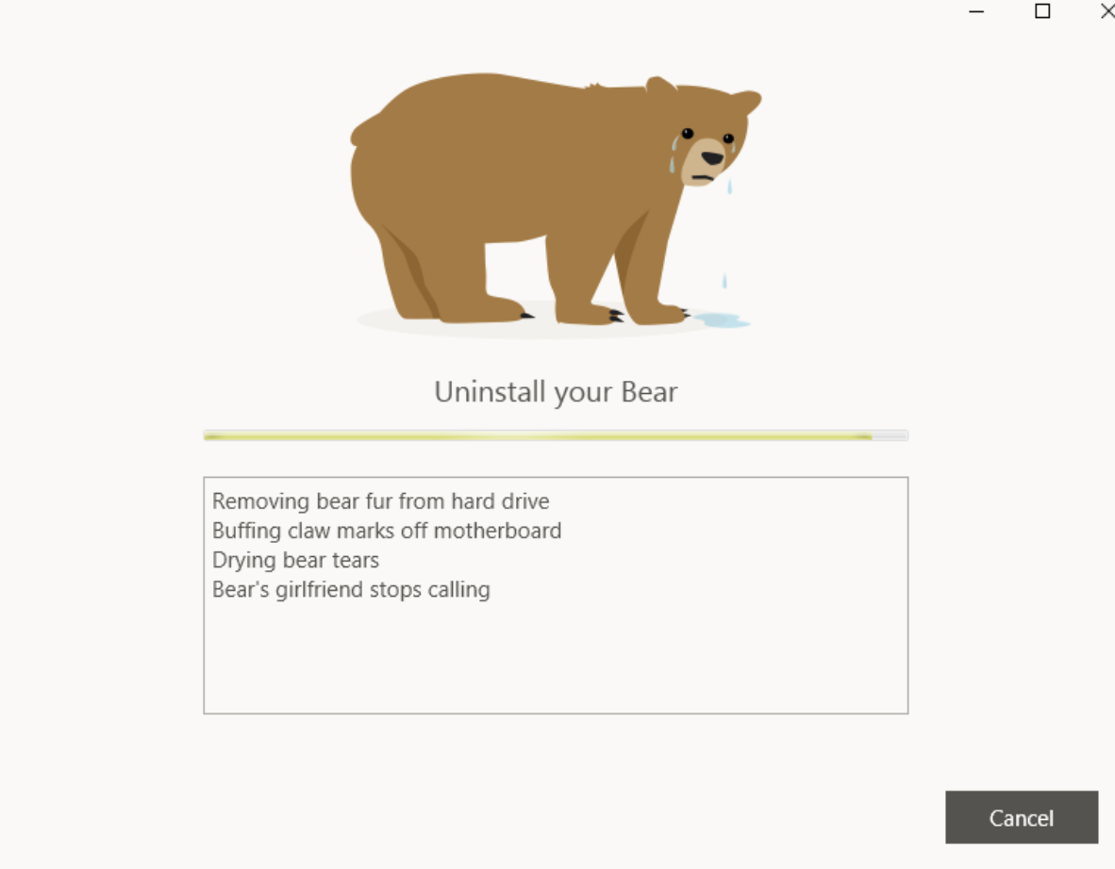
Examples of Emotional Interaction in Products

Slide 8
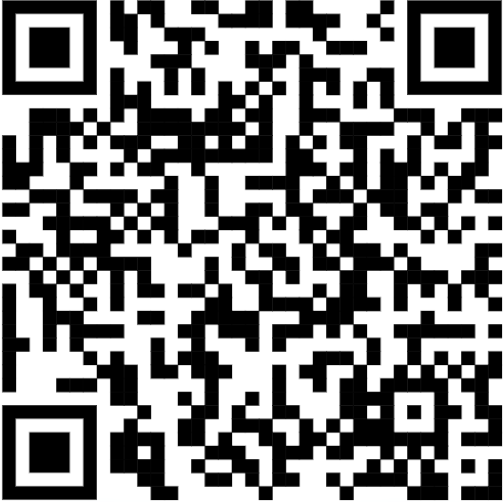
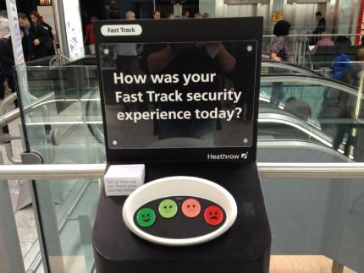
Examples of Emotional Interaction in Products
HappyOrNot

Slide 9
How Do Emotions Affect Behavior?
Expression
Facial Expressions
Body Language
Gestures
Tone of Voice
People react to other people’s expressions, changing their own behavior

Slide 10
How Do Emotions Affect Behavior?
Expression
Facial Expressions
Body Language
Gestures
Tone of Voice
People react to other people’s expressions, changing their own behavior

Slide 11
How Do Emotions Affect Behavior?
(Driving)
Angry Driving (Pêcher et al., 2011; Zhang and Chan, 2016)
More Aggressive Driving
Take More Risks
More Error Prone
Listening to Music while Driving (Christelle Pêcher et al. (2009))
Happy Music: Drivers slow down, ability to stay in lane worsened
Sad Music: Drivers slow down
Neutral music: No effect

Slide 12
The Levels of the Brain
Visceral Level
Responds Automatically to Events
Controls emotional responses to stimuli
Behavioral Level
Controls Everyday Behavior
Most human activities occur here
Reflective Level
Controls contemplation

Slide 13
The Levels of the Brain
Visceral Level Design
Making products look, feel, and sound good
Behavioral Level Design
Making products usable
Reflective Level Design
Making products important or meaningful to a certain culture or person

Slide 14
Sidharth Topic: 6.3: Expressive Interfaces and Emotional Design
“Everything has a personality: everything sends an emotional signal. Even where this was not the intention of the designer, the people who view the website infer personalities and experience emotions.”
— Don Norman

Slide 15
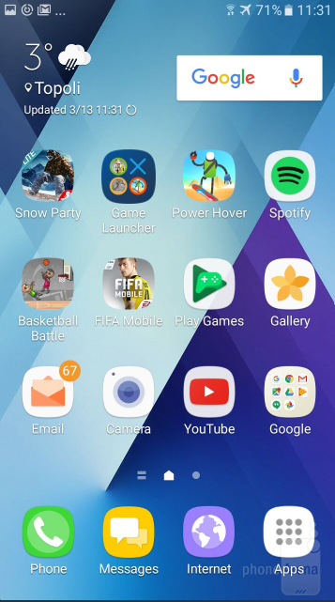
6.3.1 What is Expressive Interfaces?
The expressive interface allows us to convey emotion, to provide satisfaction with empathy and to delight with contextually-aware illustrations and animations.
Expressive Interfaces are a critical component of modern designs, with such a wide variety of choices for consumers, companies that want their products to be successful must not only lower the barrier of knowledge needed to operate their systems, but also make their systems desirable to use. Today’s smartphones are one of the current pinnacles of expressive interface design.
Expressive Interface design can be achieved in a number of ways, that modern designs typically use several of to create a cohesive and satisfying user experience.
Dynamic icons such as the recycling bin on a computer desktop changing based on the amount of deleted files within it, or icons with text bubbles indicating the number of unread messages on smartphones are both good examples of dynamic icons that convey useful information in an unobtrusive but efficient way.
Another way in which smartphones make use of good expressive interface design is Vibrotactility in their feedback, having the phone vibrate when you press keys on the digital keyboard to simulate the feedback you get from typing on a physical keyboard and specific vibration patterns depending on the notifications being received are examples of this.

Slide 16


6.3.2 What is Emotional Design?
Emotional design is the concept of how to create designs that evoke emotions which result in positive user experiences.
Designers aim to reach users on three cognitive levels—visceral, behavioral and reflective—so users develop only positive associations (sometimes including negative emotions) with products, brands, etc.
The fact is that the emotional design of a product or service affects its success—and thus the bottom line.
In the last five years alone, our user interfaces have gotten smarter. Not just from a technological and computational perspective, but also an emotional one.

Slide 17
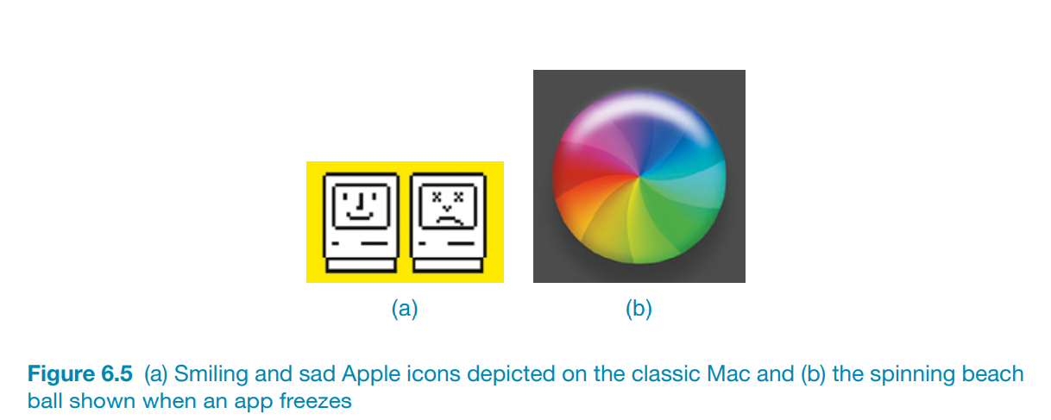
6.3.3 Little bit History of Expressive Interfaces and Emotional Design
Designers use a number of features to make an interface expressive. Emojis, sounds, colors, shapes, icons, and virtual agents are used to (1) create an emotional connection or feeling with the user (for instance, warmth or sadness) and/or (2) elicit certain kinds of emotional responses in users, such as feeling at ease, comfort, and happiness.
In the early days, emotional icons were used to indicate the current state of a computer or a phone, notably when it was waking up or being rebooted.
A classic from the 1980s was the happy Mac icon that appeared on the screen of the Apple computer whenever the machine was booted (see Figure 6.5a). The smiling icon conveyed a sense of friendliness, inviting the user to feel at ease and even smile back. The appearance of the icon on the screen was also meant to be reassuring, indicating that the computer was working.
After being in use for nearly 20 years, the happy and sad Mac icons were laid to rest.
Apple now uses more impersonal but aesthetically pleasing forms of feedback to indicate a process for which the user needs to wait, such as “starting up,” “busy,” “not working,” or “downloading.” These include a spinning colorful beach ball (see Figure 6.5b) and a moving clock indicator.
Similarly, Android uses a spinning circle to show when a process is loading.

Slide 18
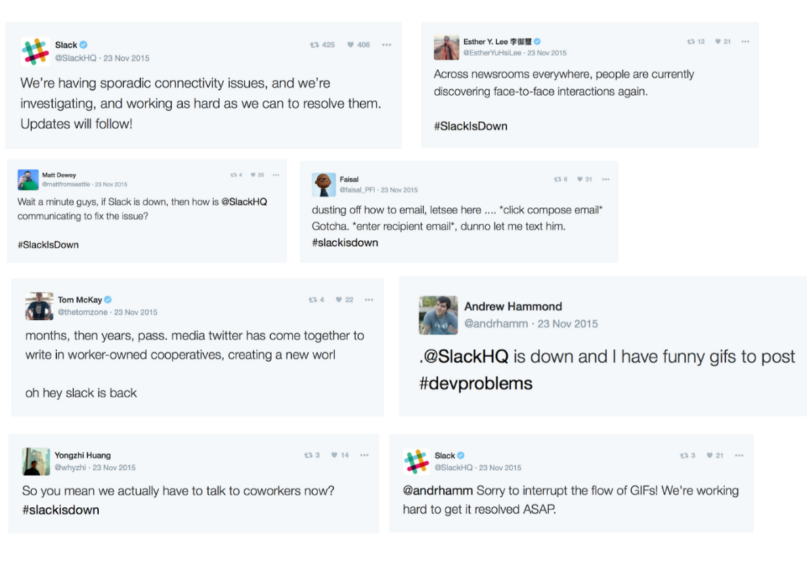
6.3.4 Harnessing Expressive Interface & Emotional design techniques wins trust and helps us to create a user-centric environment for our interactive processes
Winning Trust
Back in November 2015, Slack suffered it’s first major outage and brought tech to a standstill. Most people made light of the intermittent downtime by taking to Twitter to post a joke or two.
As designers, we know that users will be generally be more tolerant of intermittent malfunctions, providing our interface was designed from a user-centric perspective. We can say with some certainty that Slack’s users are more tolerant to downtime because of the investment Slack has made to capture human equity.
Slack’s user experience design is practically a seminar in capturing user trust .

Slide 19
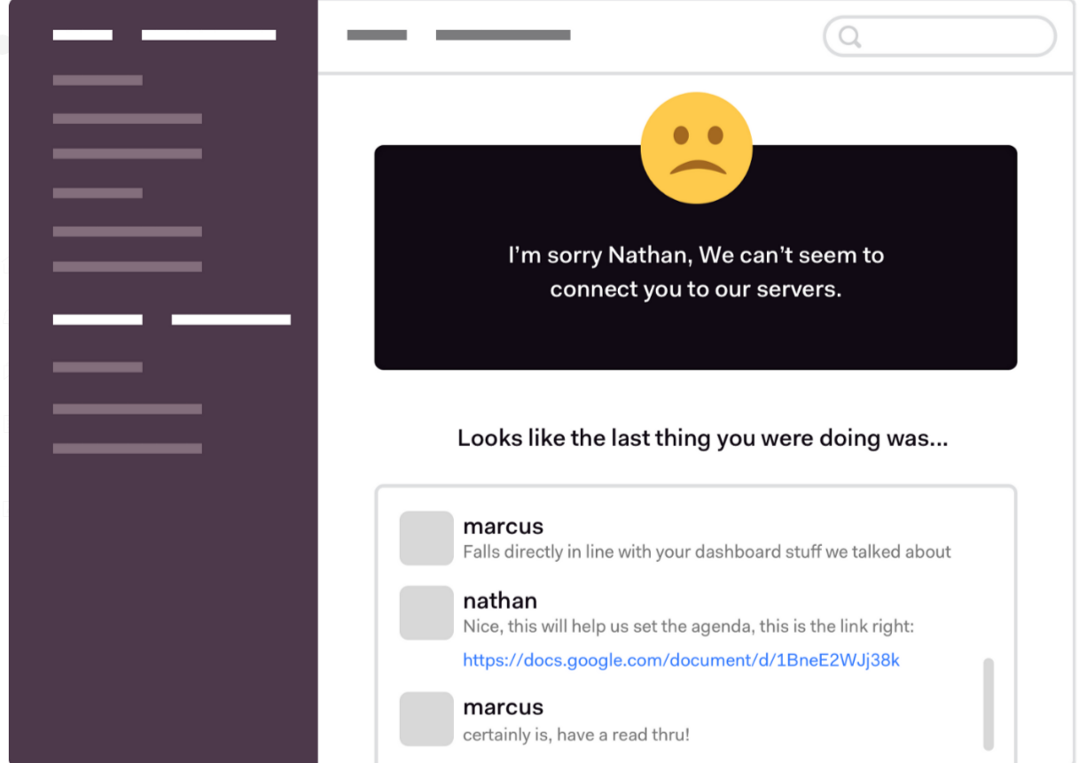
2. Add Context with Pragmatic Interactions
Relieving user frustration through pragmatic interactions is one of the primary ways for Designers to build user tolerance as referenced above.
Thinking about design in this way would allow designers to alert users that a component failure has occurred. Such an alert could deliver empathic and contextual communication to minimize the perceived and actual effect of that downtime on a user.
The user would quickly be able to re-orient themselves and continue going about their critical tasks, ultimately buying Slack’s Product Team a little bit more fault tolerance.

Slide 20
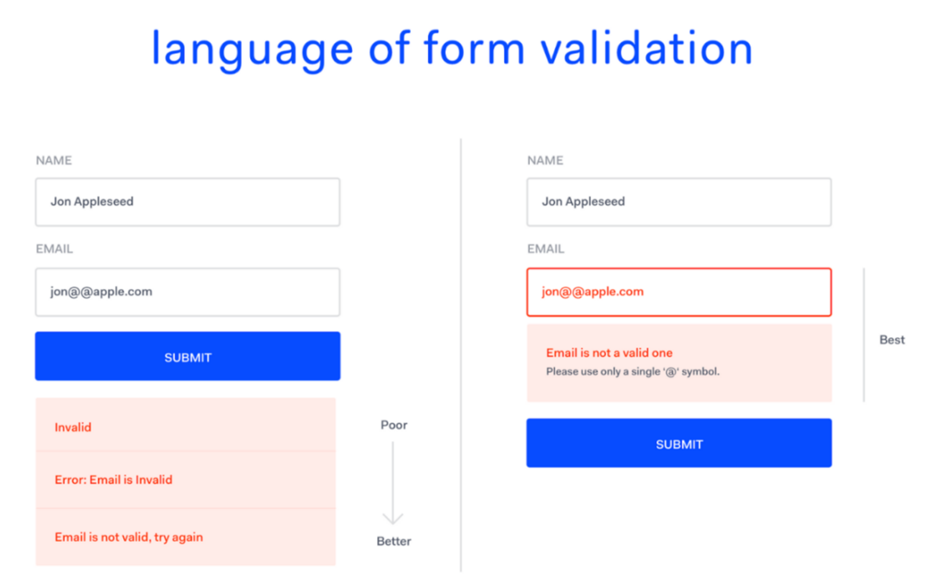
3. Humanist Language as System Default
People trust computers when they speak more like humans.
The scope to reduce friction and frustration through an expressive interface is massive. Such interfaces have been scientifically proven to have an effect on the willingness of users to persevere despite frustration.
A group of researchers at Harvard (Klein, J., Moon Y., and Picard, R. W.) inserted a dialogue strategy known to be effective at relieving negative emotion directed towards a frustrating computer interaction flow. The researchers’ hypothesis was that when a computer system creates frustration on the part of the user, it can relieve that frustration quickly and effectively by means of active emotional support.
‘This form is invalid’ — Avoid negative language. Users want reassurance not negativity
Designers should try to avoid negativity in Interaction Design. Users want reassurance, not negativity.

Slide 21
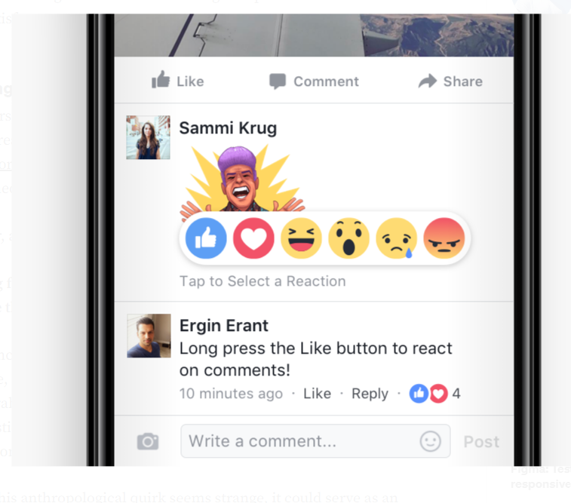
4. Emotions to Increase Reassurance and Retention
Surveying the technological landscape today, interactive systems are being used to provoke user responses in ways that were previously unachievable or unrealistic. Designers today should recognize the opportunity to shape user journeys and craft interfaces that provoke context-aware emotional responses.
The role of emotional expression in interaction design is not to build artificial humans to talk to our users, but rather to harness anthropomorphism as a conduit through which social interaction can be utilized for user benefit.
In the near future, it’d be easy to imagine scenarios in which Siri reacts to every sigh and Google shows understanding of repeated searches that don’t provide satisfactory results.
Remember, anthropomorphism means:
Attributing familiar humanlike qualities to non-human entities, allowing us to perceive those entities as more familiar, explainable or predictable.

Slide 22
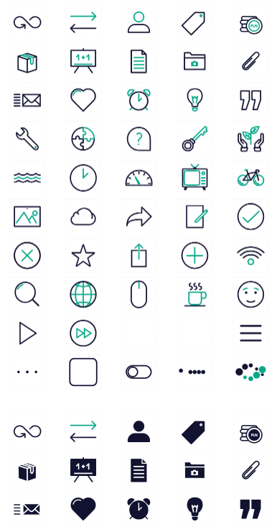
6.3.5 Other ways of Expressive Interface?
Animated icons (for example, a recycle bin expanding when a file is placed in it and paper disappearing in a puff of smoke when emptied)
Sonifications indicating actions and events (such as whoosh for a window closing, “schlook” for a file being dragged, or ding for a new email arriving)
Vibrotactile feedback, such as distinct smartphone buzzes that represent specific messages from friends or family

Slide 23
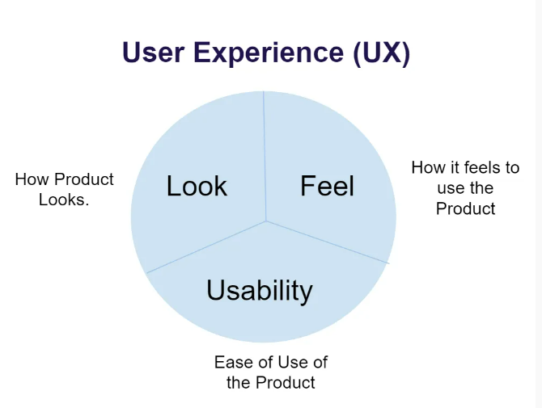
6.3.6 Aesthetically Interfaces
The style or brand conveyed by an interface, in terms of the shapes, fonts, colors, and graphical elements used, and the way they are combined, also influence its emotional impact. Use of imagery at the interface can result in more engaging and enjoyable experiences (Mullet and Sano, 1995). A designer can also use a number of aesthetic techniques such as clean lines, balance, simplicity, white space, and texture.
The benefits of having aesthetically pleasing interfaces have become more acknowledged in interaction design. Noam Tractinsky (2013) has repeatedly shown how the aesthetics of an interface can have a positive effect on people’s perception of the system’s usability. When the look and feel of an interface is pleasing and pleasurable—for example through beautiful graphics or a nice feel or the way that the elements have been put together—people are likely to be more tolerant and prepared to wait a few more seconds for a website to download. Furthermore, good-looking interfaces are generally more satisfying and pleasurable to use.

Slide 24
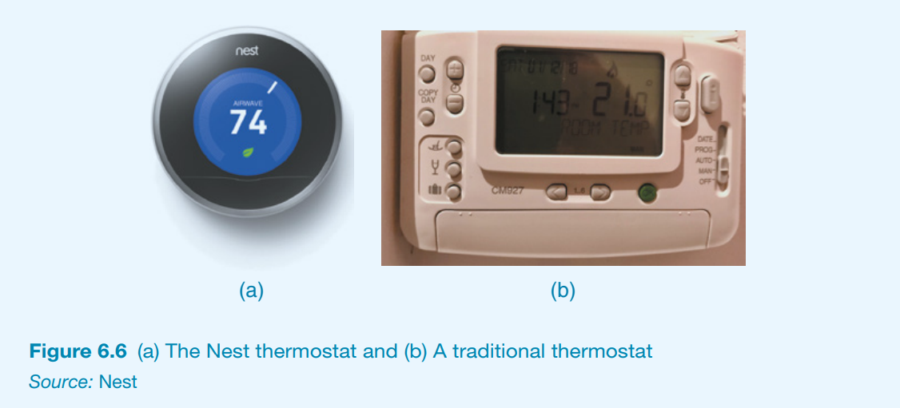
6.3.7 The Design of the Nest Thermostat Interface?
The popular Nest thermostat provides an automatic way of controlling home heating that is personalized to the habits and needs of the occupants. Where possible, it also works out how to save money by reducing energy consumption when not needed. The wall-mounted device does this by learning what temperature the occupants prefer and when to turn the heating on and off in each room by learning their routines.
The Nest thermostat is more than just a smart meter, however. It was also designed to have a minimalist and aesthetically pleasing interface (see Figure 6.6a). It elegantly shows the temperature currently on its round face and to which temperature it has been set. This is very different from earlier generations of automatic thermostats, which were utilitarian box-shaped designs with lots of complicated buttons and a dull screen that provided feedback about the setting and temperature (see Figure 6.6b). It is little wonder that the Nest thermostat has been a success.

Slide 25
Maryam Topic: 6.4 Annoying Interface

Slide 26
When is a user interface annoying?

Slide 27
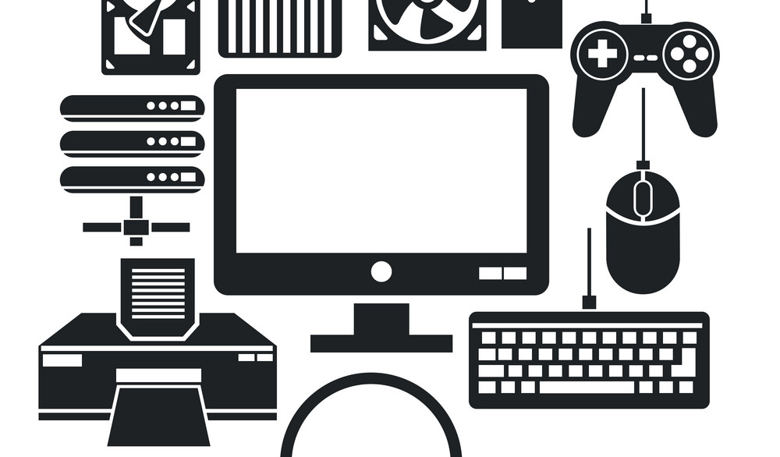
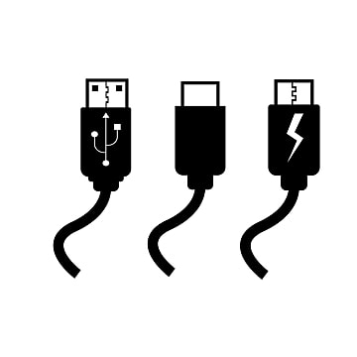
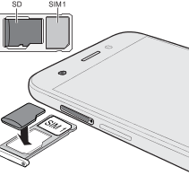
User interface of a device or application that should be simple, but it is complex
The most common examples are : remote controls, printers, digital alarm clocks, and digital TV systems. Getting a printer to work with a new digital camera, trying to switch from watching a DVD to a TV channel, and changing the time on a digital alarm clock in a hotel can be very trying. Also, complex actions such as attaching the ends of cables between smartphones and laptops, or inserting a SIM card into a smartphone

Slide 28
What Are Approaches?
Helping users to become familiarized with a technology
These methods include pop-up help boxes and contextual videos.
Make an interface appear friendlier as a way of reassuring users
- Especially users who were new to computers or online banking
- One technique that was first popularized in the 1990s was the use of cartoon-like companions.

Slide 29
samples of annoying interfaces

Slide 30
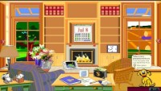
Microsoft Bob Agent
Bob, aimed at new computer users. It was presented as friendly character, including a pet dog and a cute bunny. An interface metaphor of a warm, cozy living room, intended to convey a comfortable feeling.
Why Bob never became a commercial product?
Many people did not like the idea of Bob, finding the interface too cute and childish

Slide 31
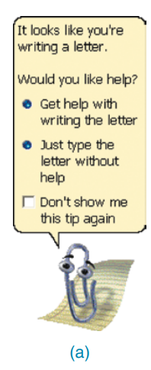
Microsoft Clippy Agent
Microsoft did not give up on the idea of making its interfaces friendlier and developed other kinds of agents, including the infamous Clippy (a paper clip that had human-like qualities).
Clippy typically appeared at the bottom of a user’s screen whenever the system thought the user needed help carrying out a particular task. It was depicted as a cartoon character. Clippy was released as a commercial product.
It was not a success since many Microsoft users found it too intrusive, distracting them from their work.

Slide 32
What are the effects of bad designs?

Slide 33


Interfaces, if designed poorly, can make people sometimes feel insulted, stupid, or threatened. The effect can be to annoy them to the point of losing their temper.

Slide 34
What are some situations that cause negative emotional responses?

Slide 35
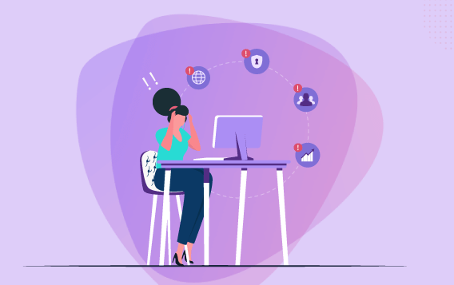
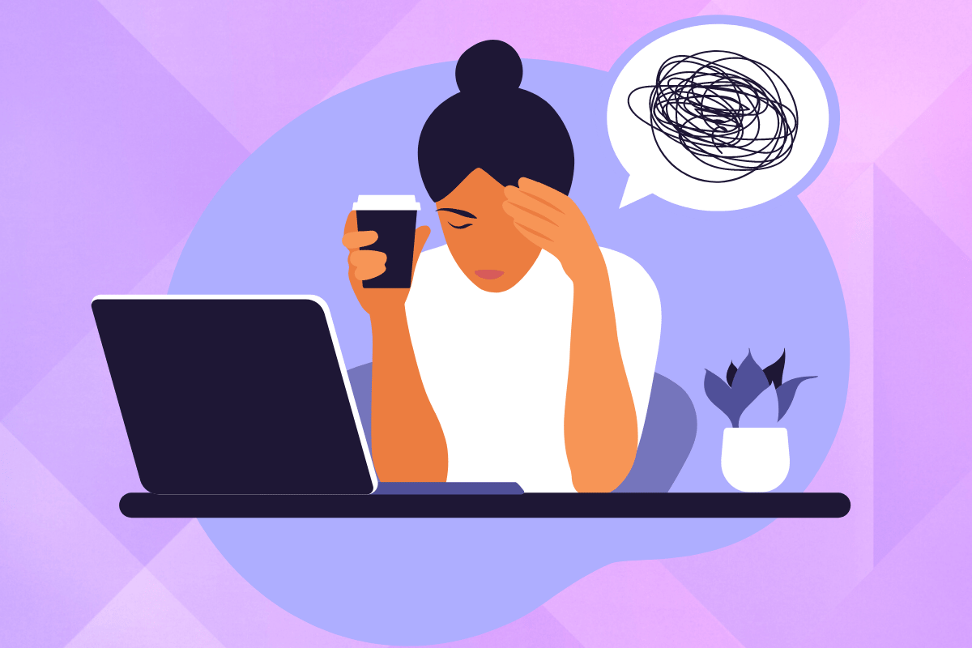
• When an application doesn’t work properly or crashes
• When a system doesn’t do what the user wants it to do
• When a user’s expectations are not met

Slide 36
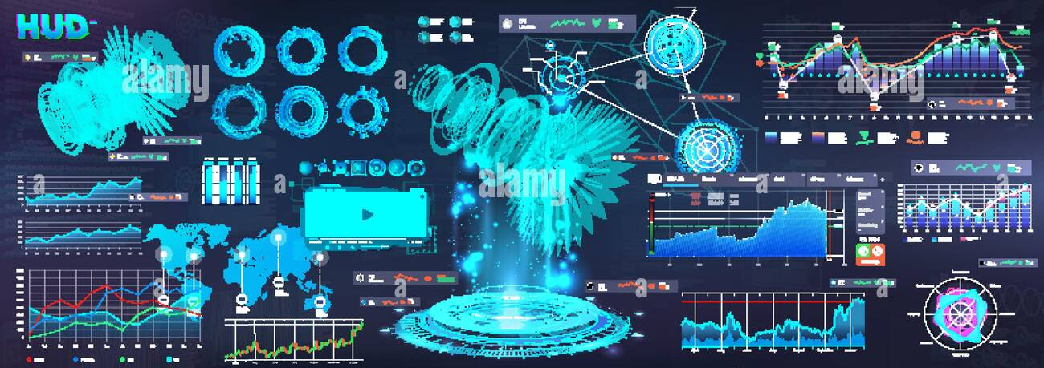
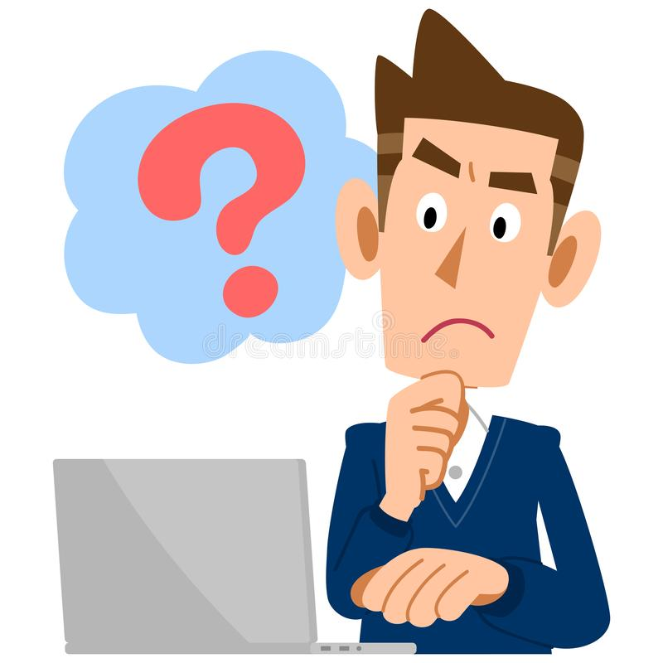
• When a system does not provide sufficient information to let the user know what to do
• When error messages pop up that are vague or obtuse
• When the appearance of an interface is too noisy, garish, gimmicky, or patronizing

Slide 37
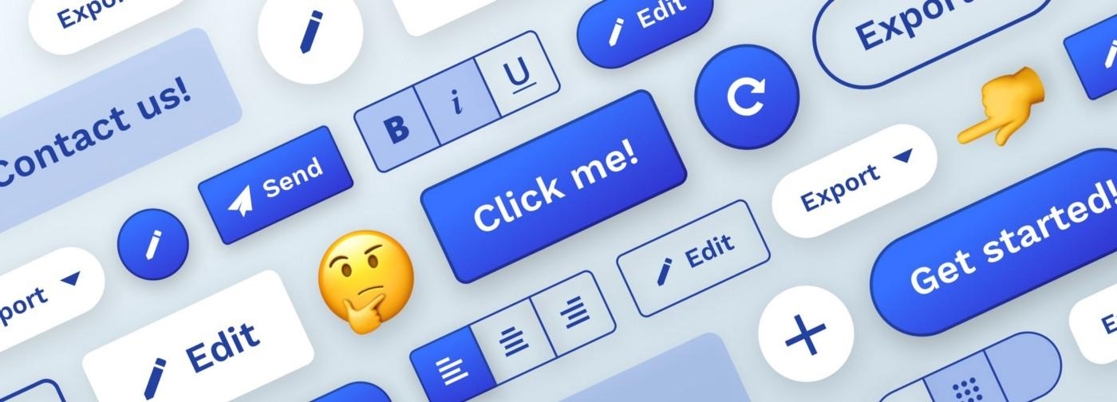
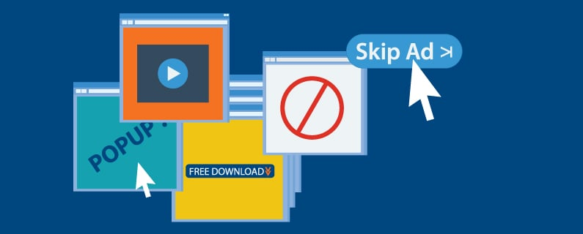
• Flashing animations, especially flashing banner ads and pop-up ads that cover the user view and which require them to click in order to close them
• Featuritis—an excessive number of operations, such as an array of buttons on remote controls

Slide 38
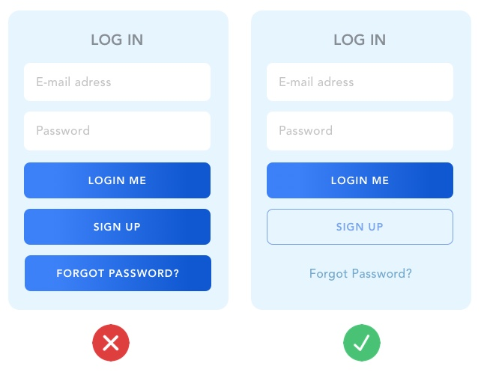
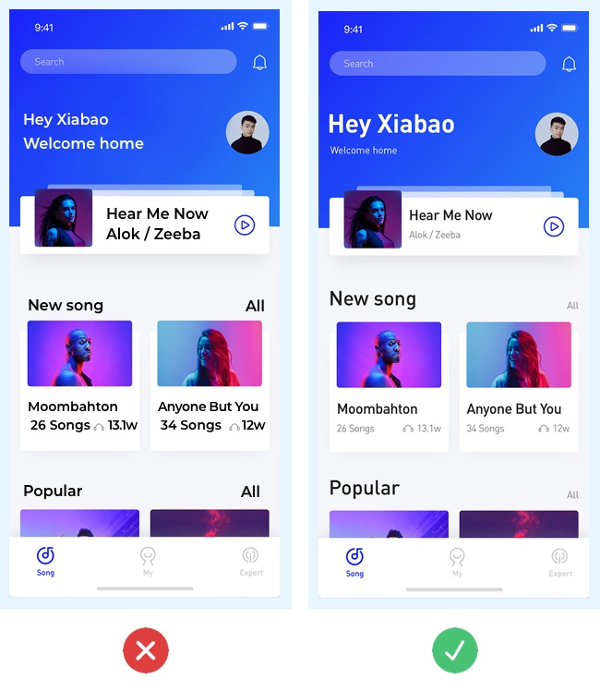
Little distinction between primary and secondary buttons
Lack of text hierarchy

Slide 39
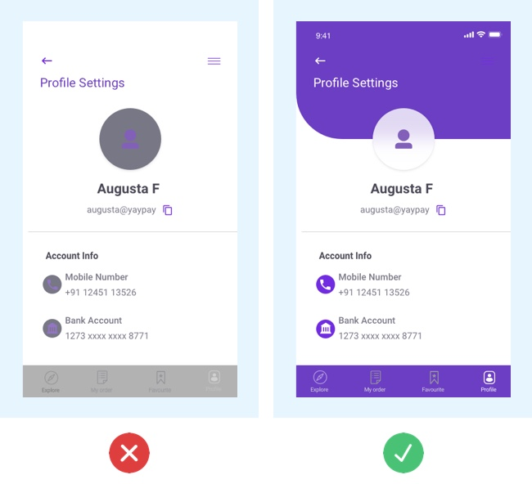
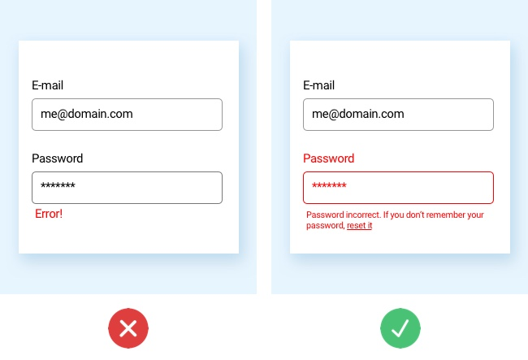
Low contrast
Confusing forms

Slide 40
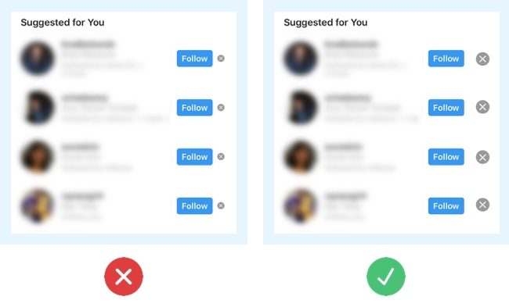
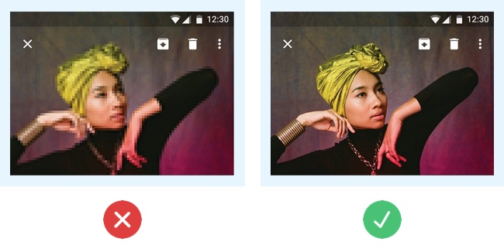
Poor touch target on mobile and tablet
Using irrelevant or low-quality images

Slide 41
Nikshep Topic: 6.5 Affective computing and emotional AI

Slide 42
Affective computing and Emotional AI
Emotional AI is a field of study that aims to automate the measurement of emotions and actions by employing affective computing and AI technology that can detect emotions from voice and facial expressions.
Affective computing is concerned with how to use computers to recognize and express emotions in the same way as humans do (Picard, 1998).
It includes creating new methods to assess frustration, tension, and moods by examining people's expressions and discussions, as well as providing means for people to transmit their emotional states through the novel and wearable sensors.
Example: forecasting what someone is most likely to buy online when feeling sad, bored, or happy.

Slide 43
Techniques and Technology
Cameras for measuring facial expressions
Biosensors placed on fingers or palms to measure galvanic skin response (which is used to infer how anxious or nervous someone is as indicated by an increase in their sweat).
Affective expression in speech (voice quality, intonation, pitch, loudness, and rhythm).
Body movement and gestures, as detected by motion capture systems or accelerometer sensors placed on various parts of the body

Slide 44
Automated facial expressions
gaining popularity in commercial settings, especially in marketing and e-commerce
Example: Affectiva's Affdex emotion analytics software uses computer vision and machine learning algorithms to catalog a user's emotional responses to digital content as recorded through a webcam.
This information is used to determine how engaged the user is with digital online content, such as movies, online stores, and advertisements.
Affectiva website: https://www.affectiva.com/

Slide 45
Automated facial expressions
Six fundamental emotions are classified based on the facial expressions that Affdex collects.
Anger
Contempt
Disgust
Fear
Joy
Sadness

Slide 46
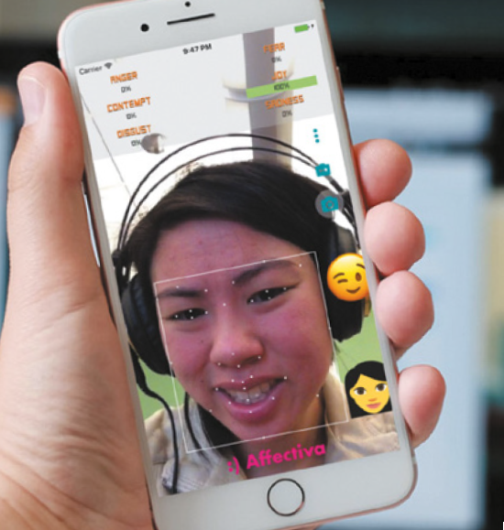
Automated facial expressions
Smiling
Eye widening
Brow raising
Brow furrowing
Raising a cheek
Mouth opening
Upper-lip raising
Wrinkling of the nose

Slide 47
Automated facial expressions
When a person is browsing, Based on the emotional state at that point, the website can adapt its ad, movie storyline or content.
If a user screws up their face when an ad pops up, this suggests that they feel disgust.
Whereas if they start smiling, it suggests that they are feeling happy.
This information is used to determine how engaged the user is with digital online content, such as movies, online stores, and advertisements.

Slide 48
Automated facial expressions
Affectiva has also started to analyze drivers’ facial expressions when on the road with the goal of improving driver safety.
Example: a virtual agent in the car might suggest to the driver to take a deep breath and play soothing music to help relax them. In addition to identifying particular emotions through facial expressions (for example, joy, anger, and surprise), Affectiva uses particular markers to detect drowsiness. These are eye closure, yawning, and blinking rate.
Again, upon detecting when a threshold has been reached for these facial expressions, the software might trigger an action, such as getting a virtual agent to suggest to the driver that they pull over where it is safe to do so.

Slide 49
Automated facial expressions
There are some other indirect methods to reveal the emotional state of someone include eye-tracking, finger pulse, speech, and the words/phrases they use when tweeting, chatting online, or posting to Facebook (van den Broek, 2013).
The level of affect expressed by users, the language they use, and the frequency with which they express themselves when using social media can all indicate their mental state, well-being, and aspects of their personality (for instance, whether they are an extrovert or introvert, neurotic or calm, and so on).
This type of indirect emotion detection is beginning to be used to help infer or predict someone’s behavior, for example, determining their suitability for a job or how they will vote in an election.

Slide 50
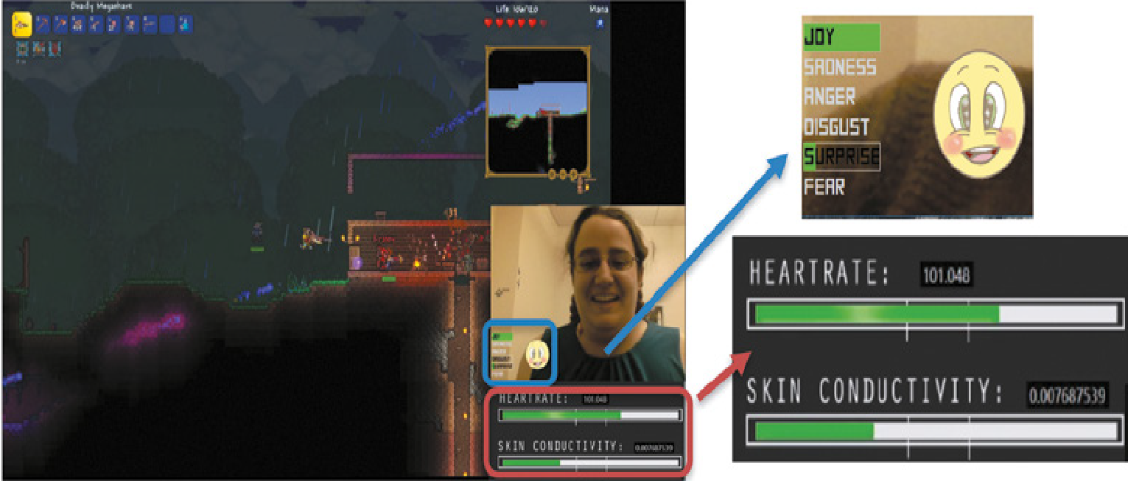
Automated facial expressions

Slide 51
Activity
Is It OK for Technology to Work Out How You Are Feeling?
Do you think it is ethical that technology is trying to read your emotions from your facial expressions or from what you write in your tweets and, based on its analysis, filter the online content that you are browsing, such as ads, news, or a movie to match your mood? Might some people think it is an invasion of their privacy?

Slide 52
Daniel Topic: 6.6 Persuasive Technologies and Behavioral Change & 6.7 Anthropomorphism

Slide 53
6.6 Persuasive Technologies and Behavioral Change
Daniel Benjamin

Slide 54
What is Persuasive Design?
An area of design practice that focuses on influencing human behavior through a product’s or service’s characteristics.
Based on psychological and social theories, persuasive design is often used in e-commerce, organizational management, and public health.
Techniques include enticing , cajoling, or nudging someone into doing something through the use of persuasive technology

Slide 55
What is Persuasive Technology?
Type of technology designed to change attitude or behavior of users.
Emphasis is on changing someone's habits or doing something that will improve an individual's well-being through monitoring their behavior.

Slide 56
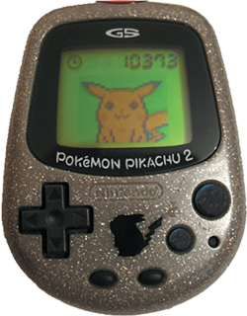
Examples of Persuasive Technologies
Nintendo's Pokémon Pikachu
Designed to motivate children to be more physically active on a consistent basis
Owner of pet that lives in device was required to walk, run, or jump each day to keep it alive
Wearer received credits in the forms of Watts for each step taken which could be used to buy Pikachu presents
If owner did not exercise for a week, the virtual pet became angry and refused to play
Major takeaway:
This use of positive rewarding and sulking can be a power means of persuasion.

Slide 57
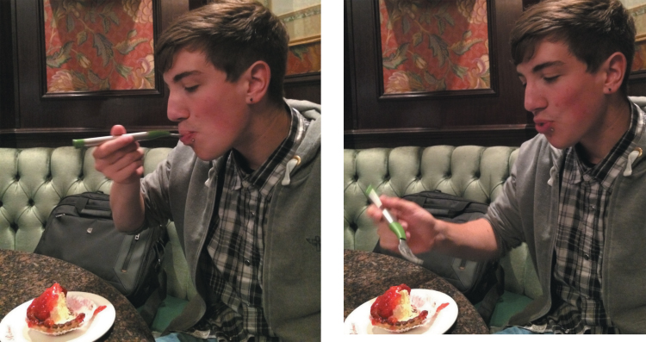
Examples of Persuasive Technologies
HAPIfork
Device that was developed to help someone monitor and track their eating habits
If it detects that they are eating too quickly, it will vibrate (similar to the way a smartphone does when on silent mode), and an ambient light will appear at the end of the fork, providing the eater with real-time feedback intended to slow them down.
Assumption is that eating too fast results in poor digestion and poor weight control and that making people aware that they are gobbling their food down can help them think about how to eat more slowly at a conscious level.
Additional Data Collected includes: how long it took them to finish their meal, the number of fork servings per minute, and the time between them
Data turned into dashboard of graphs and statistics so that the user can see each work whether their fork behavior is improving.

Slide 58
Examples of Persuasive Technologies
Nowadays, there are many kinds of mobile apps and personal tracking devices available that are intended to help people monitor various behaviors and change them based on the data collected and displayed back to them.
Devices include: Fitness and weight trackers (Fitbit, smart scales)
These results can also be compared, through online leaderboards and charts, with how well they have done versus their peers and friends.
Other techniques employed to encourage people to exercise more or to move when sedentary include goal setting, reminders, and rewards for good behavior.

Slide 59
Examples of Persuasive Technologies
An alternative approach to collecting quantified data about a behavior automatically is to ask people to write down manually how they are feeling now or to rate their mood and for them to reflect upon how they felt about themselves in the past.
A mobile app called Echo, for example, asked people to write a subject line, rate their happiness at that moment, and add a description, photos, and/or videos if they wanted to (Isaacs et al., 2013).
People who used the Echo app reported on the many positive effects of doing so, including reliving positive experiences and overcoming negative experiences by writing them down. The double act of recording and reflecting enabled them to generalize from the positive experiences and draw positive lessons from them.

Slide 60
6.7 Antromorphism
Daniel Benjamin

Slide 61
Antropomorphism
The propensity people have to attribute human qualities to animals and objects.
For example, people sometimes talk to their computers as if they were humans, treat their robot cleaners as if they were their pets, and give all manner of cute names to their mobile devices, routers, and so on.

Slide 62

How Antropomorphism Impacts Design?
Anthropomorphic form works best when it’s used to tell a story or say something about what a product does.
It can be used to build brand identity, but it can also help users understand how and where to use products.
Power tools, for instance, often take a more masculine form.
Their hard edges and chamfered angles are associated with strength, power, and durability. This form signals that the products are tough, rugged, and durable.

Slide 63
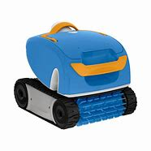
How Antropomorphism Impacts Design?
Products with smooth, soft, round edges have more feminine or baby-like traits.
Often seen in products meant to be handled delicately and those that have a cute or playful element.
Aqua Products pool-cleaning robots were given an almost turtle-like shape.
The form is fun and playful, which is fitting for a poolside setting, and it almost looks like a creature that’s meant to live in the water.

Slide 64
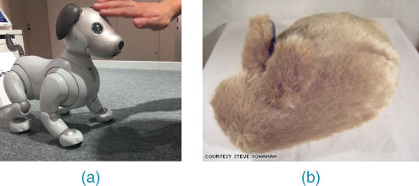
Activity - A Robot or a Cuddly Pet?
Early robot pets, such as Sony's AIBO, were made of hard materials that made them look shiny and clunky. In contrast, a more recent trend has been to make them look and feel more like real pets by covering them up in fur and making them behave in more cute, pet-like ways.
Two contrasting examples are presented in Figures a and b. Which do you prefer and why?

Slide 65
Thank You
http://www.free-powerpoint-templates-design.com

